Slide 1
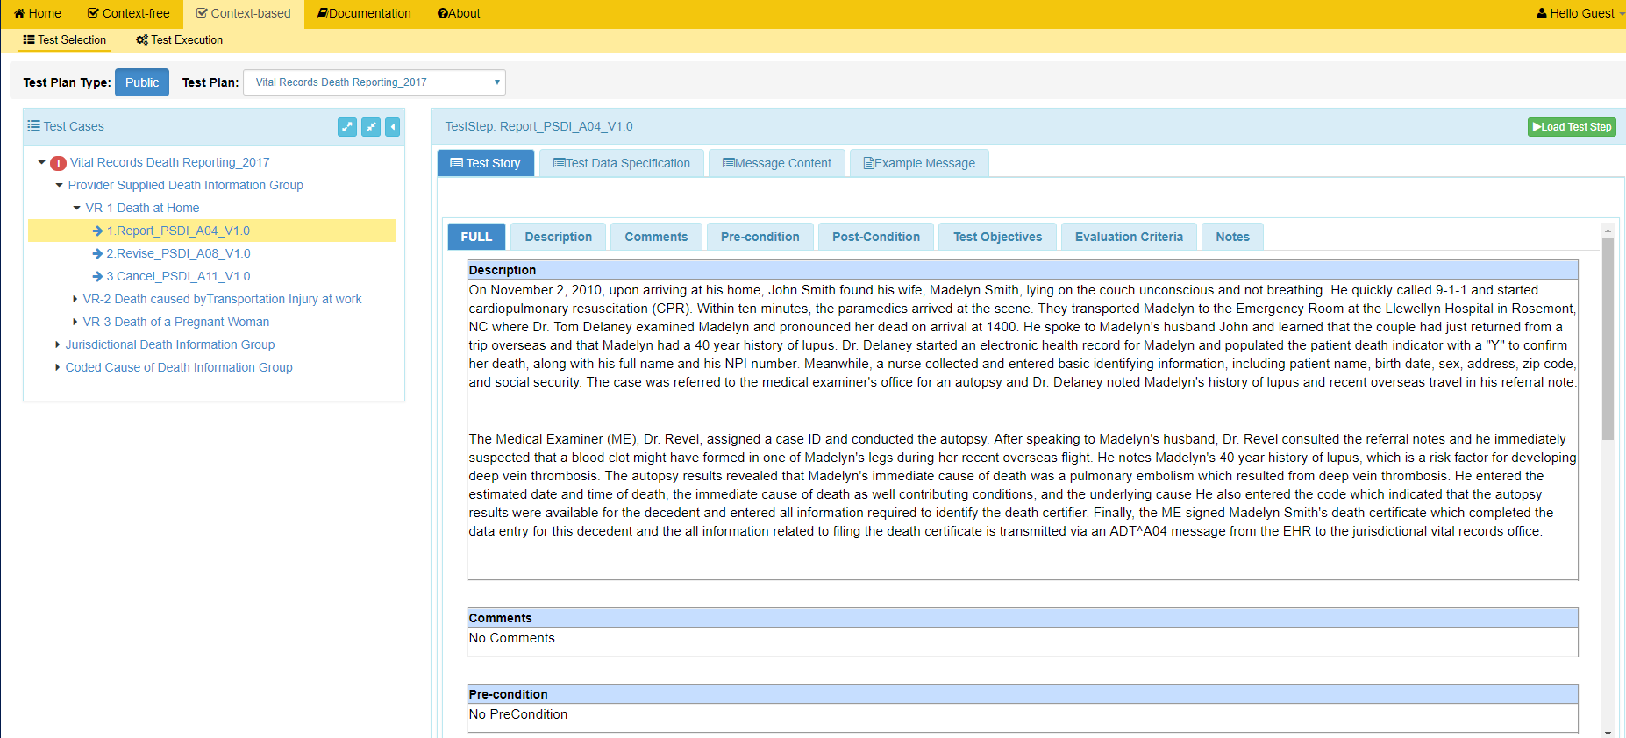
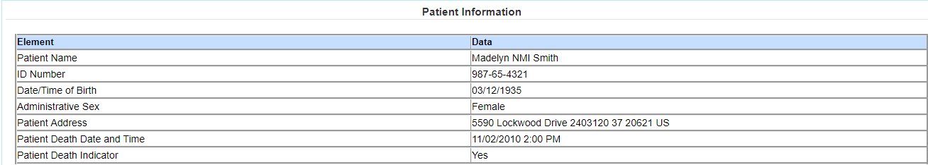
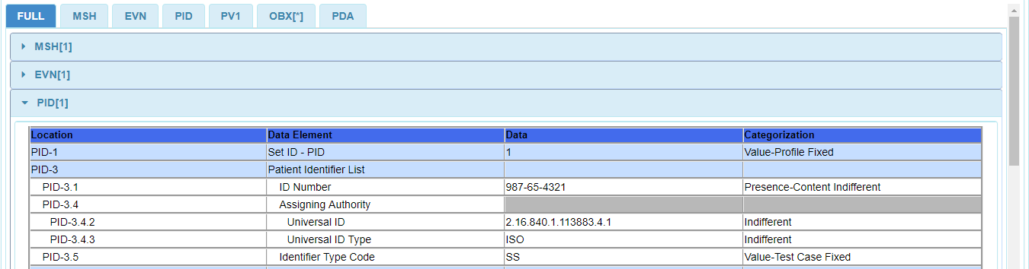
Context-based – Test Execution via “Test Step” Test Selection (1)
1
3
5
Select Context-based from the Menu Bar.
Select a Test Step.
Access Test Step Test Data Specification, Message Content, or an Example Message.
2
Select a Test Plan.
4
6
Click the Load Test Step button.
The Test Step Test Story displays.
See next slide
View of Test Data Specification
View of Message Content
Notes:
Script: To use the Context-based type testing in GVT, the user must select Context-based from the menu bar. The tool will activate the Test Selection panel and a test step must be selected from the Test Cases drop down list. When a test step is selected the tool displays the Test Story on the right panel. The Test Story provides a use case scenario for the test case. The test story includes additional information such as Comments, Pre-condition, Post-condition, Test Objectives, Evaluation Criteria, and Notes to Tester. This information can be accessed by scrolling down or by selecting from the Test Story tabs. In this screen the user is also provided access to the test step Test Data Specification, Message Content and an Example message.
The TDS provides the data associated with the test story and consists of information that is typically available in a clinical setting.
The Message Content is another artifact that shows the HL7 message elements and the data associated with the message elements for a given test case. It can be used to assist the Tester in loading the SUT with the Test case specific data.
Click the Load Test Step tab to load the test step for execution.

Slide 2
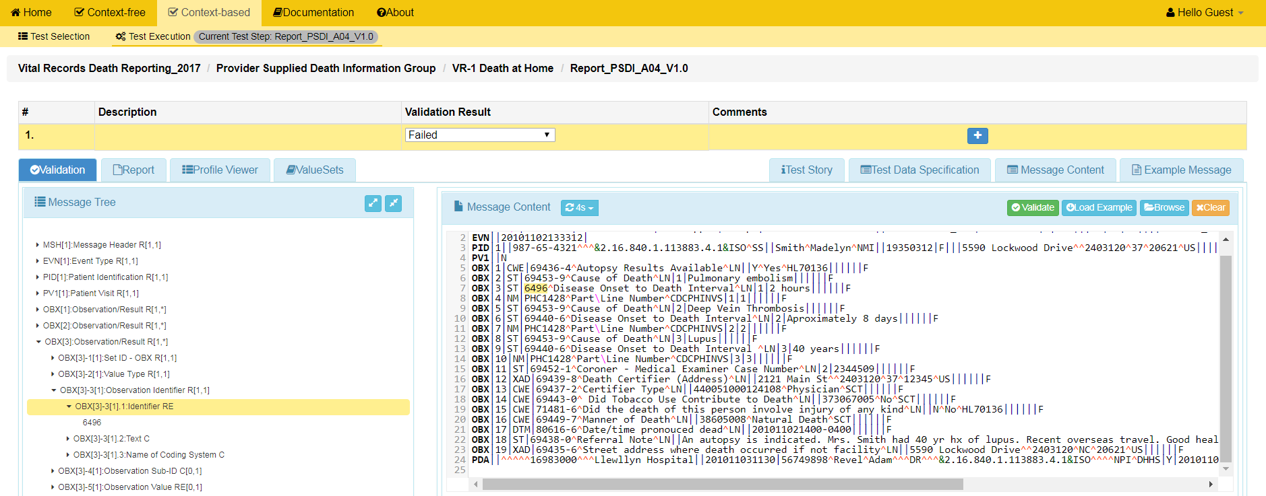
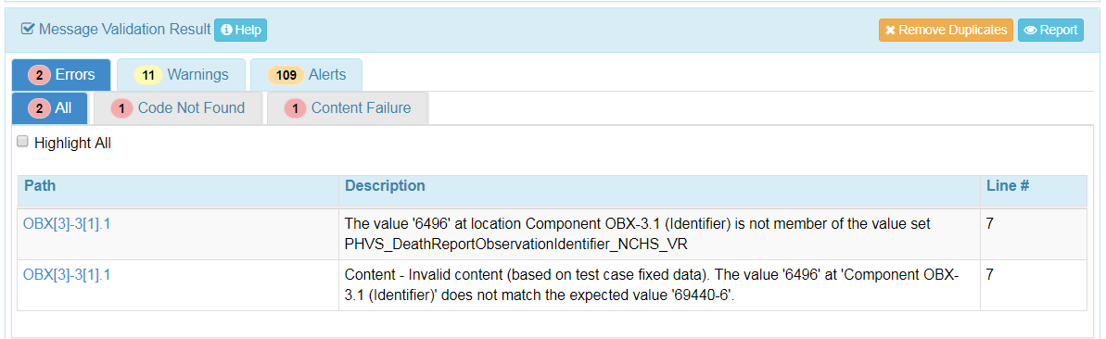
Context-based – Test Execution via “Test Step” Test Selection (2)
7
Load the message into the Message Content window.
8
Click the Validate button to initiate validation of the message.
Access to Test Step Test Story, Test Data Specification, Message content or an Example Message
View the validation results displayed in the Message Validation Result window.
9
10
Click on the Report button to view the Message Validation Report.
Notes:
Script: After loading a test case for execution, the user then load the message to be validated into the Message Content panel and click the Validate tab to validate the message or wait for the tool to automatically validate the message. Noticed that the validation response time can be disabled or adjusted from the Message Content panel, the default is 4 seconds. The validation results is generated and displayed in the Message Validation Result panel. To see a detail report of the validation results click the Report button in the Message Validation Result panel.
In this screen the user is also provided access to the test step Test Data Specification, Message Content and an Example message.
The TDS provides the data associated with the test story and consists of information that is typically available in a clinical setting.
The Message Content is another artifact that shows the HL7 message elements and the data associated with the message elements for a given test case. It can be used to assist the Tester in loading the SUT with the Test case specific data.

Slide 3
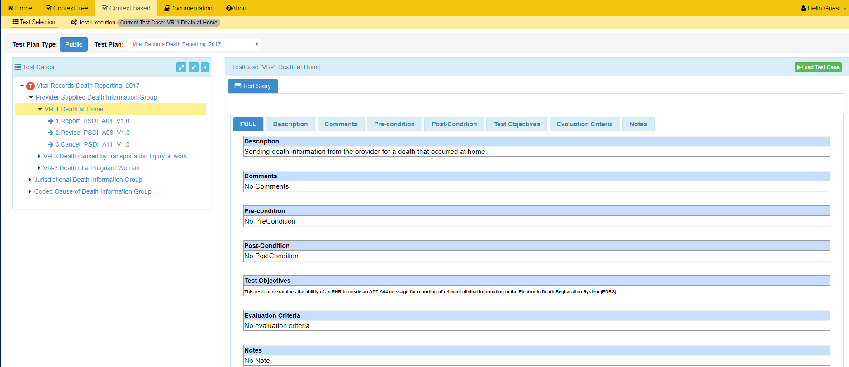
Context-based – Test Execution via “Test Case” Test Selection (1)
1
Select Context-based from the Menu Bar.
3
Select a Test Case.
5
Click the Load Test Case button.
2
Select a Test Plan.
4
Test Case Test Story displays.
See next slide
Notes:
Script: To use the Context-based type testing in GVT, the user must select Context-based from the menu bar, there is no need to have an account to access all GVT publicly released tools. The tool will activate the Test Selection panel and a or a Test Case or Test Step must be selected from the Test Cases drop down list. When a test case is selected the tool displays the Test Story on the right panel. The Test Story provides a use case scenario at the test case level. The test story includes additional information such as Comments, Pre-condition, Post-condition, Test Objectives, Evaluation Criteria and Notes. This information can be accessed by scrolling down or by selecting from the Test Story tabs.
Click the Load Test Case tab to load the test case.

Slide 4
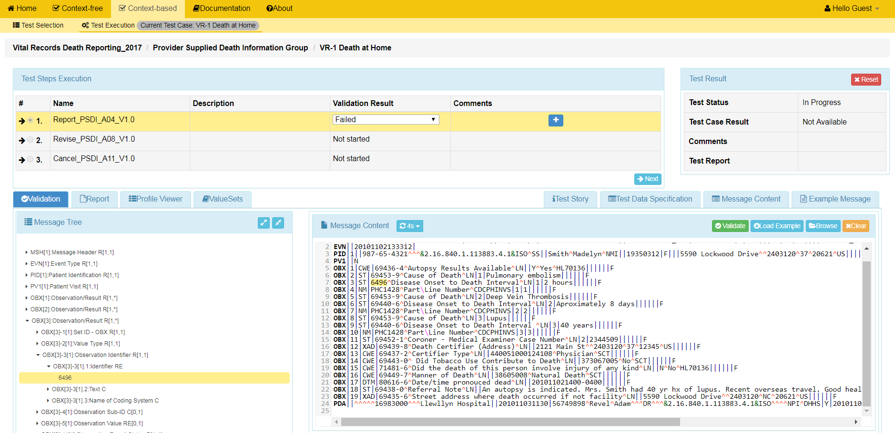
Context-based – Test Execution via “Test Case” Test Selection (2)
6
The first test step in the Test Case is selected and the Test Execution is In Progress.
7
Load the message into the Message Content window.
8
Click the Validate button to initiate validation of the message.
Access to Test Step Test Story, Test Data Specification, Message content or an Example Message
View the validation results displayed in the Message Validation Result window.
9
10
Click on the Report button to view the Message Validation Report.
Notes:
After loading a test case for execution the first test step for the test case is loaded, the user then load the message to be validated into the Message Content panel and click the Validate tab to validate the message or wait for the tool to automatically validate the message. Noticed that the validation response time can be disabled or adjusted from the Message Content panel, the default is 4 seconds. The validation results is generated and displayed in the Message Validation Result panel. To see a detail report of the validation results click the Report button in the Message Validation Result panel.
In this screen the user is also provided access to the test step Test Data Specification, Message Content and an Example message.
The TDS provides the data associated with the test story and consists of information that is typically available in a clinical setting.
The Message Content is another artifact that shows the HL7 message elements and the data associated with the message elements for a given test case. It can be used to assist the Tester in loading the SUT with the Test case specific data.

